Slide 1
Computer Vision on Different CPU Architectures
By John Pollak, John Tran, Kaung Nyi Naing & Nathan Kwan
ECE 4300 Spring 2025

Slide 2
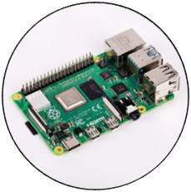
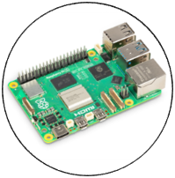
Project Overview
Object Detection for Raspberry Pi 4 vs Raspberry Pi 5
Controlled (to the best of our ability) Conditions
4 GB RAM, ARM v8 4 core CPU, Neon Instruction set, GNU/Linux 12 OS
Characteristics being tested
CPU Architecture: RISC (Pi 4) vs CISC (Pi 5)
vs.

Slide 3
Testing Methods
Geekbench
Computer Vision
Standardized benchmarking software
Collect general performance scores and object detection data points
Used to orient our expectations
Utilize a facial recognition model
Train the model on our faces via photos captured in real time
Run a live facial recognition test with the same camera
Collected Data Points:
CPU Temperature
CPU Clock Speed
Frame rate

Slide 4
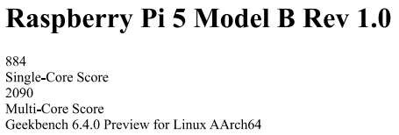
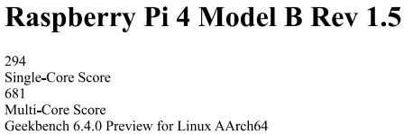
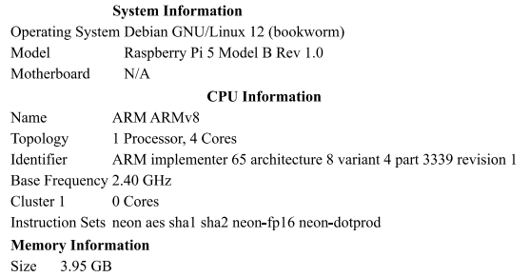
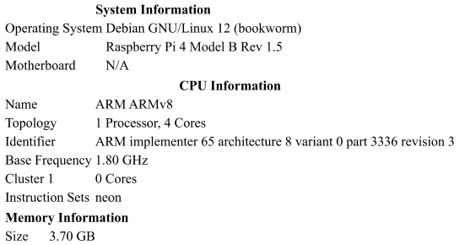
System Information with Geekbench

Slide 5
General Geekbench Benchmarks
Raspberry Pi 5
Raspberry Pi 4
Object Detection:
Single-Core: 20.6 images/sec
Multi-Core: 34.3 images/sec
Photo library:
Single-Core: 11.9 images/sec
Multi-Core: 30.5 images/sec
Background Blur:
Single-Core: 3.45 images/sec
Multi-Core: 9.93 images/sec
Object Detection:
Single-Core: 2.77 images/sec
Multi-Core: 7.99 images/sec
Photo library:
Single-Core: 3.32 images/sec
Multi-Core: 10.5 images/sec
Background Blur:
Single-Core: 0.75 images/sec
Multi-Core: 0.78 images/sec

Slide 6
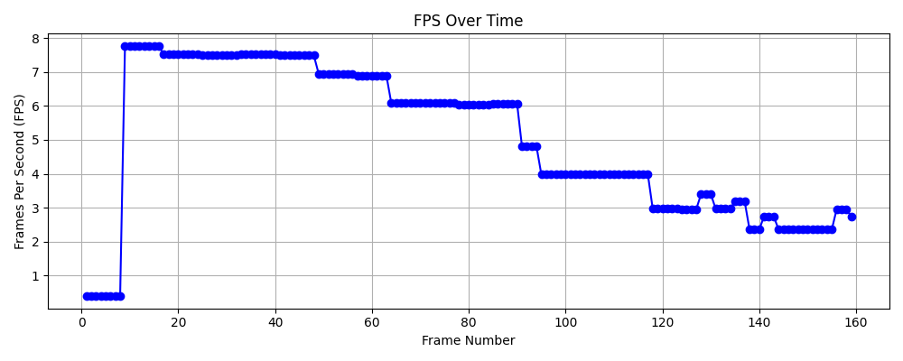
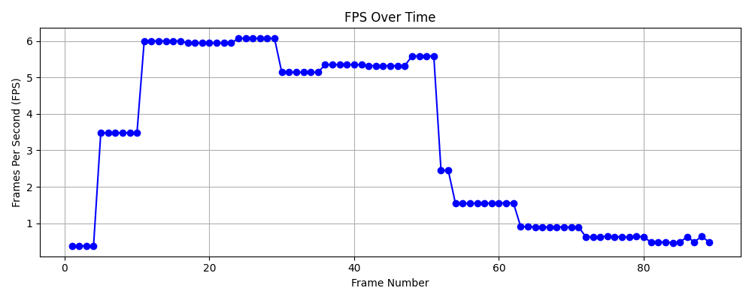
Computer Vision Benchmark
Raspberry Pi 5
Raspberry Pi 4
Note:
As we increase the workload by introducing more faces into the camera frame, the fps of both Pi 5 and 4 dropped significantly. This drop also created a lag effect where the facial detection software is many seconds behind what the actual camera is seeing.

Slide 7
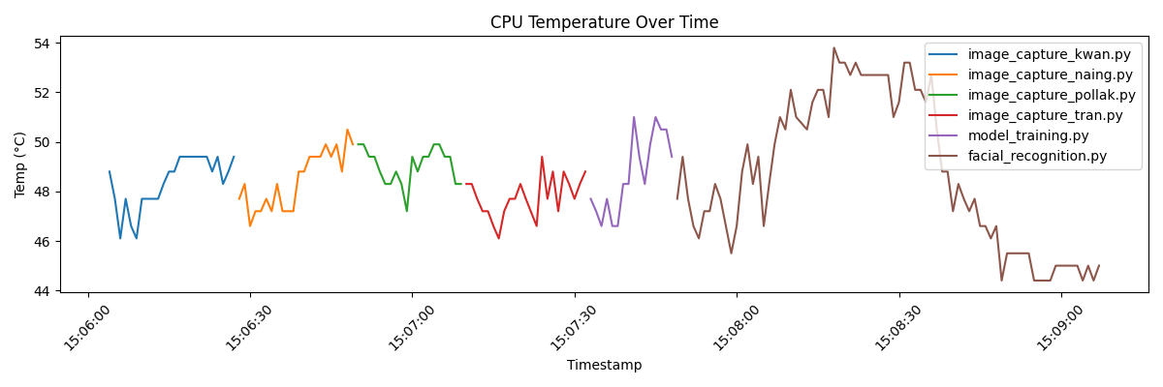
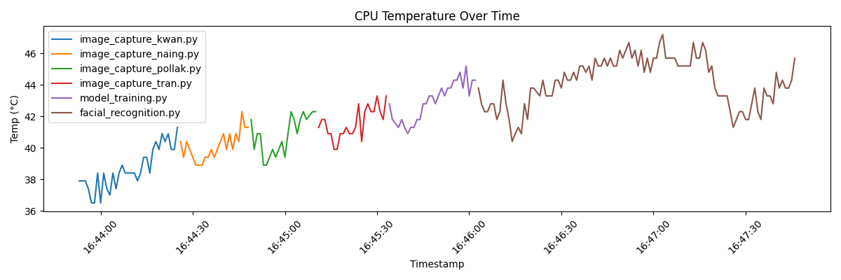
Pi 5
Pi 4

Slide 8
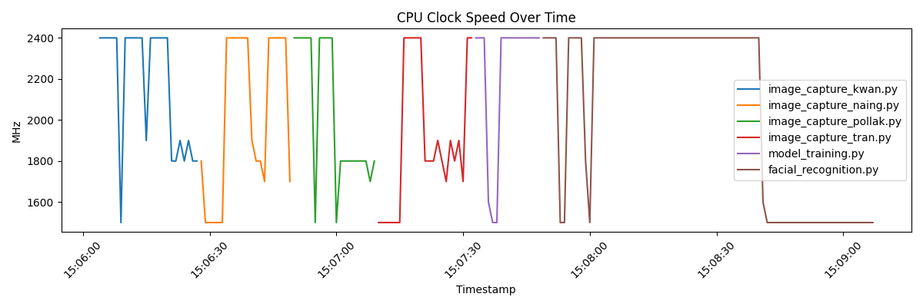
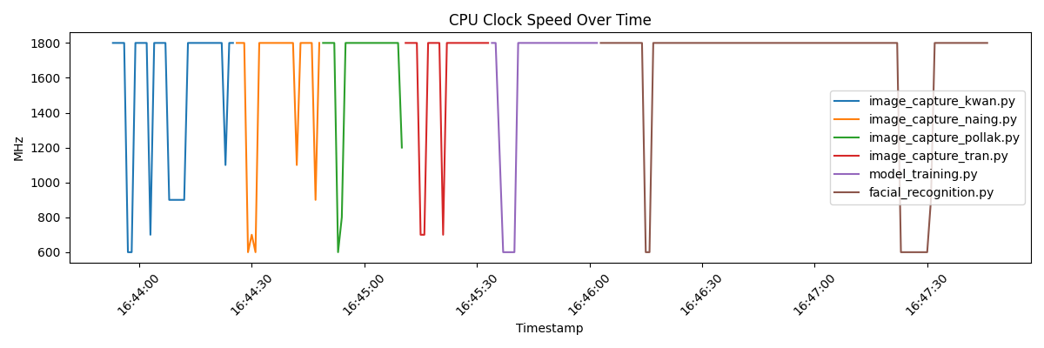
Pi 5
Pi 4

Slide 9
Data Analysis
Raspberry Pi 5
Raspberry Pi 4
Max FPS (no face in frame): 7.76
Min FPS (4 faces in frame): 2.36
CPU Temp change: 9.4 °C
CPU Clock maxed %: 55.5% @ 2400Hz
Max FPS (no face in frame): 6.07
Min FPS (4 faces in frame): 0.47
CPU Temp change: 10.7 °C
CPU Clock maxed %: 84.6 % @ 1800Hz
Pi 5 consistently had higher FPS than Pi 4, and had less lag effect when fully loaded.
Although Pi 5 started with a higher CPU temp, it had less CPU temp change compared to Pi 4.
Throughout the test period, Pi 4 run at max clock rate for more time than the Pi 5 did.

Slide 10
Conclusion and Results
Although the Pi 5 had some small advantages over the Pi 4, (such as a slightly larger memory and slightly faster max CPU frequency) the Pi 5 outperformed the Pi 4 in most of our tests by a large margin. Thus, we can conclude that for AI applications such as facial recognition, the CISC architecture is better than the RISC architecture since it provide better FPS allowing the algorithm to better detect faces. We can also conclude that higher cost of the Pi 5 is worth the performance increase when comparing to the Pi 4.

Slide 11
Thank You!
Geekbench: website link, Raspberry Pi 4, Raspberry Pi 5
Facial Recognition model: Face Recognition With Raspberry Pi and OpenCV

